Slide 1
RESURRECTION

Slide 2
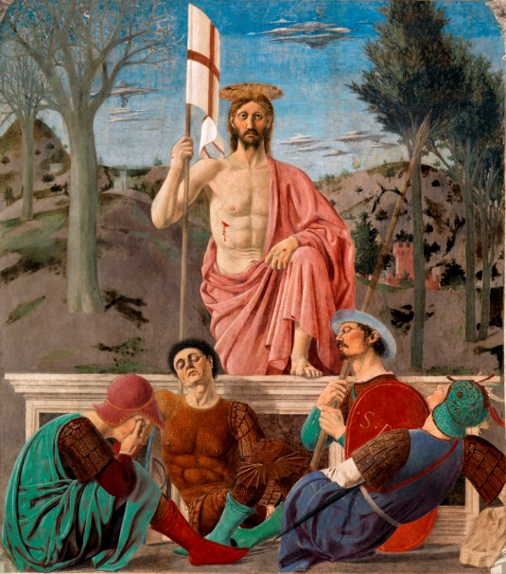
Notes:
Piero della Frnacesca c 1460

Slide 3
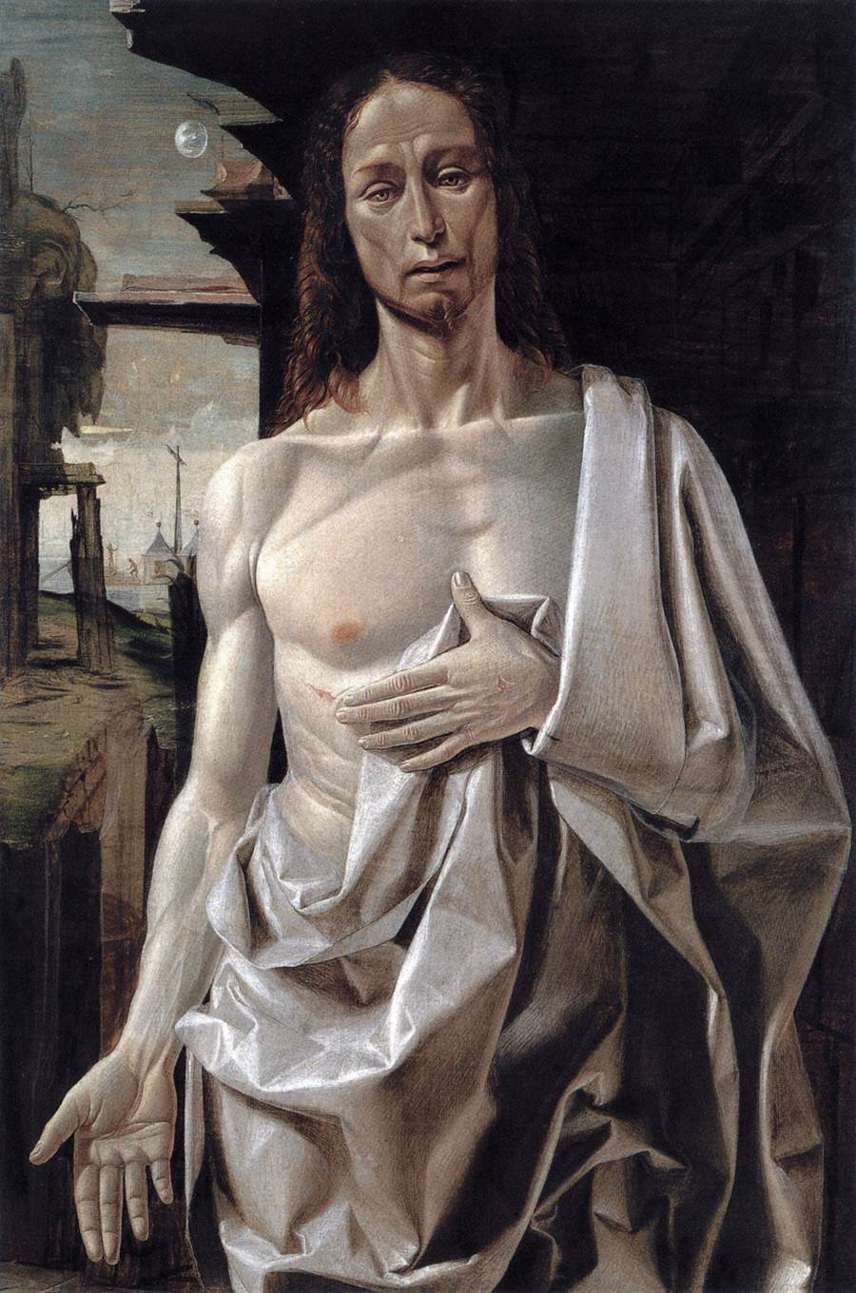
Notes:
Bramantino, cristo dolente1490

Slide 4


Slide 5
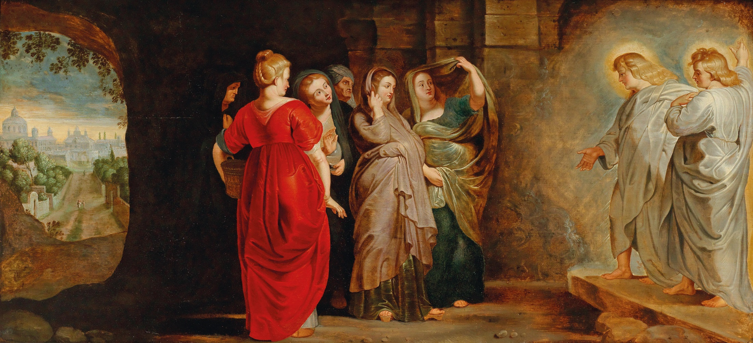
Notes:
The Women at Christ’s empty tomb., Peter Paul Rubens (1577–1640

Slide 6
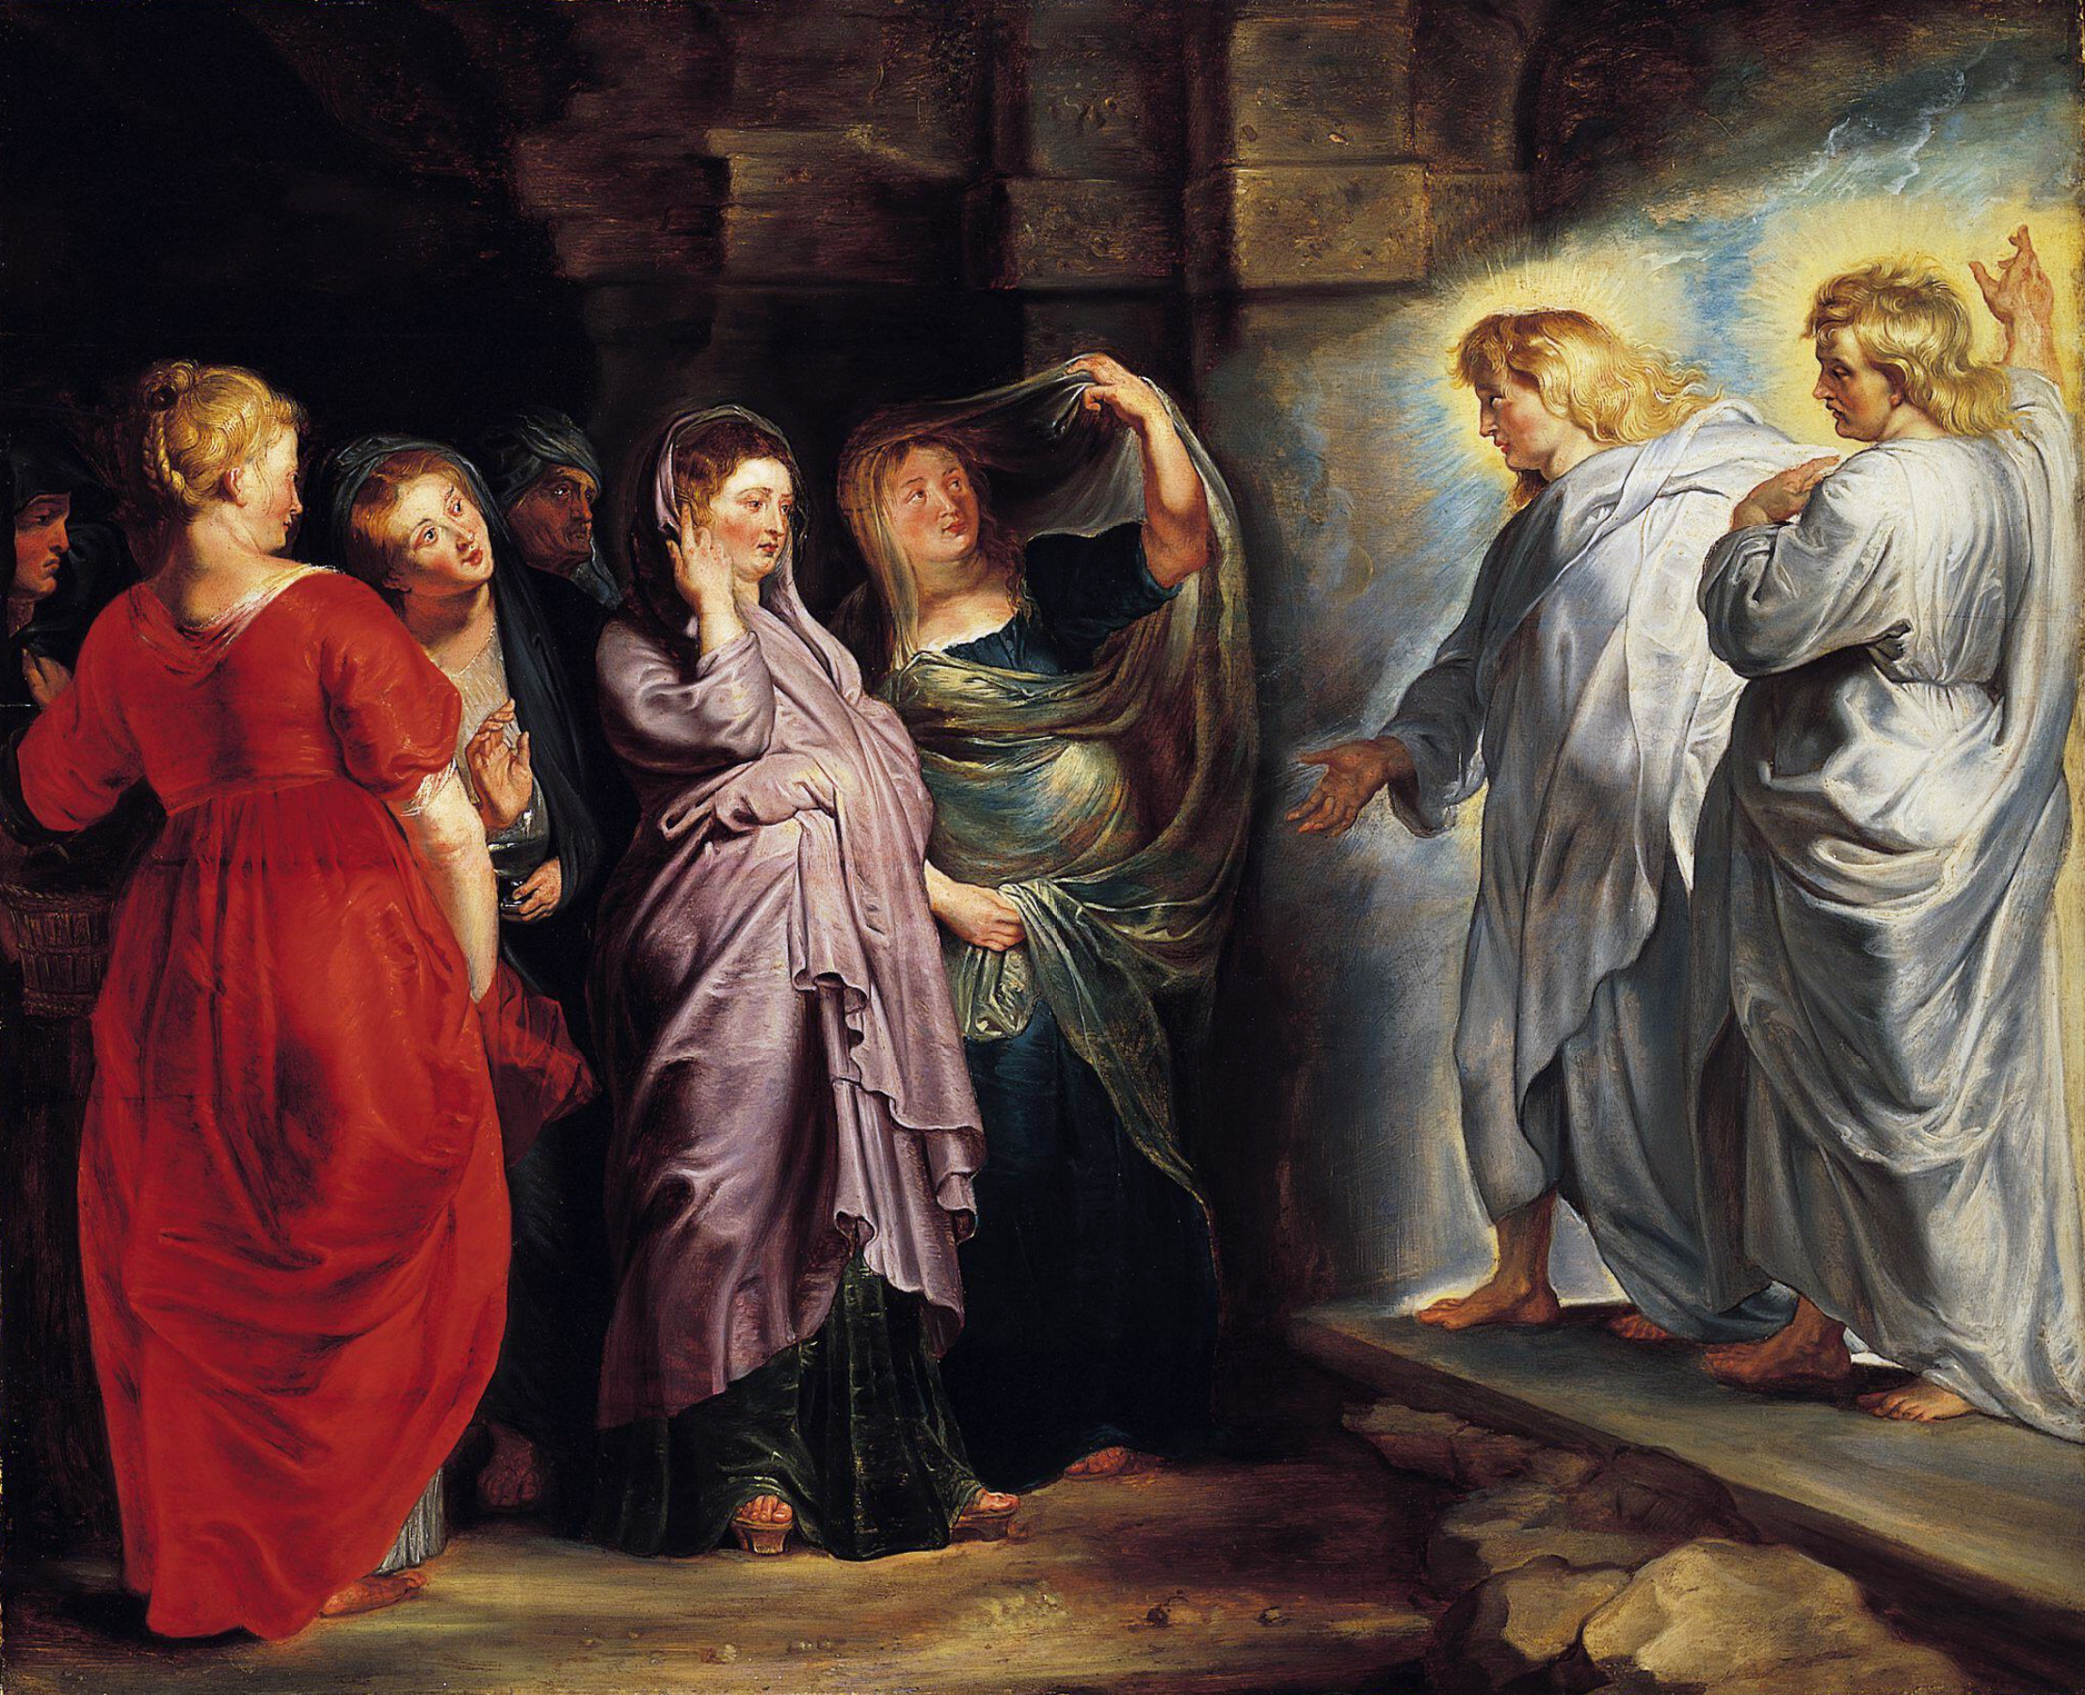

Slide 7
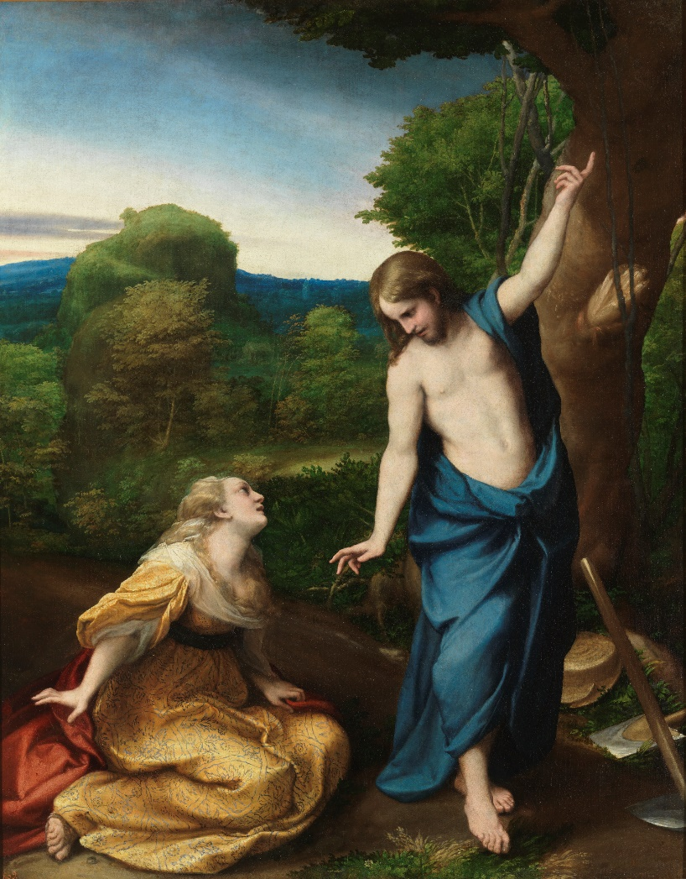
Notes:
Noli me Tangere by Antonio da Correggio, c. 1525

Slide 8
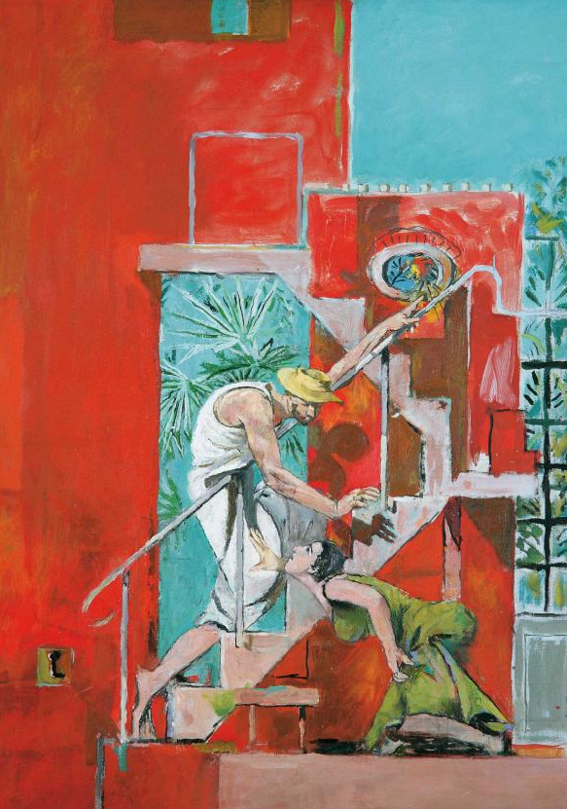
Notes:
Graham Sutherland

Slide 9
Notes:
Noli me Tangere by Antonio da Correggio, c. 1525

Slide 10
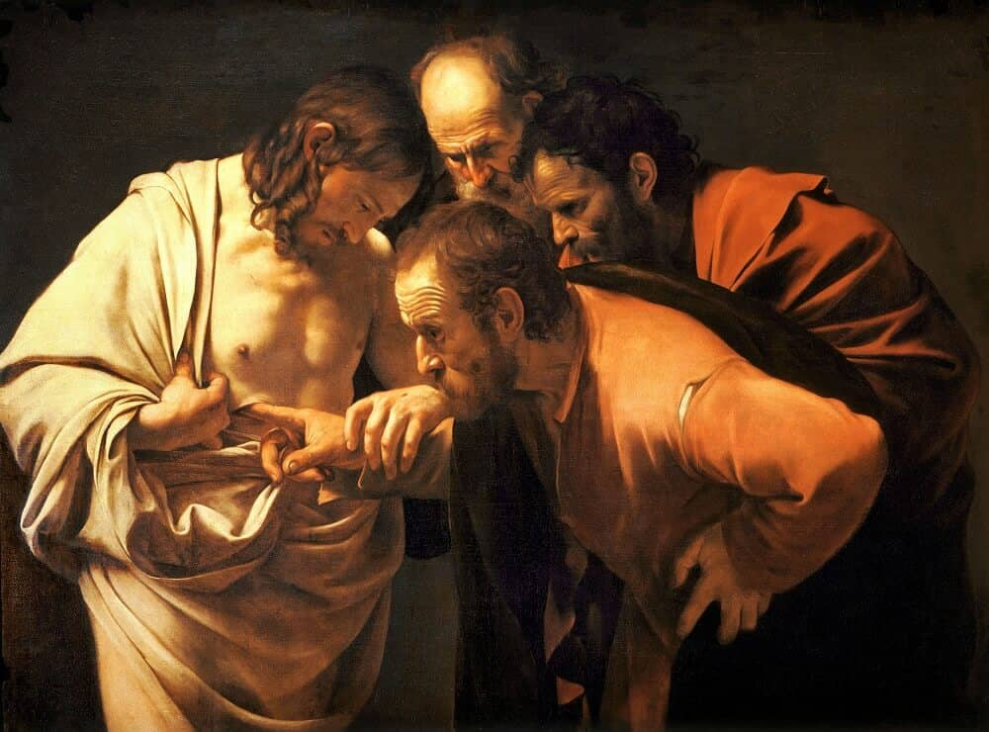
Notes:
Carravagio 1602

Slide 11
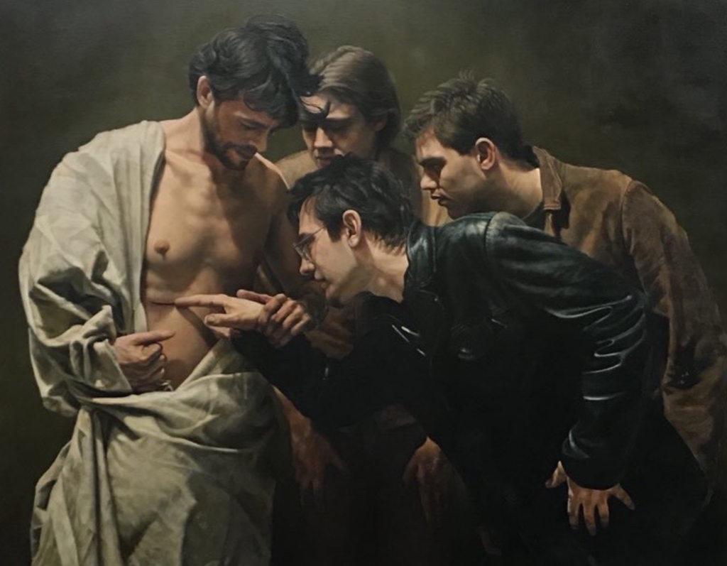
Notes:
Doubting, Painted by John Granville Gregory,
Oil on canvas, Painted in 2010, © John Granville Gregory

Slide 12
Notes:
Carravagio 1602

Slide 13
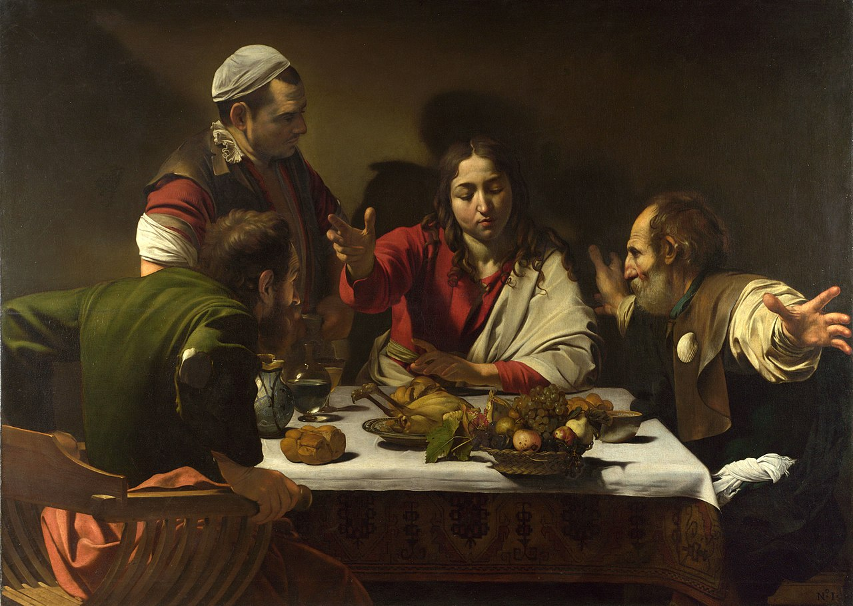

Slide 15
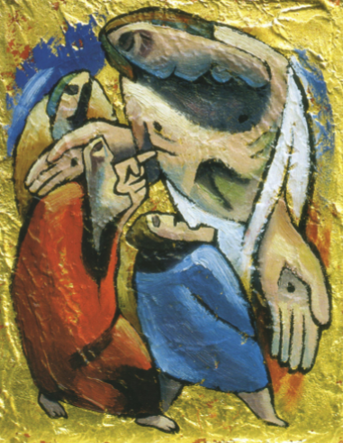
Notes:
Nicholas Mynheer 1991

